Slide 1

YOUTH VOICES SUMMIT PRESENTATION-RESEARCH BASED PROJECT
By Oduor Otieno

Slide 2

PROJECT TITLE
INCORPORATING MHEALTH INTERVENTIONS INTO KENYA’S HEALTH INFRASTRUCTURE TO AUGMENT UNIVERSAL HEALTH COVERAGE, SERVICE DELIVERY IMPROVEMENT APPROACH
DOI: https://doi.org/10.11576/seejph-4317

Slide 3
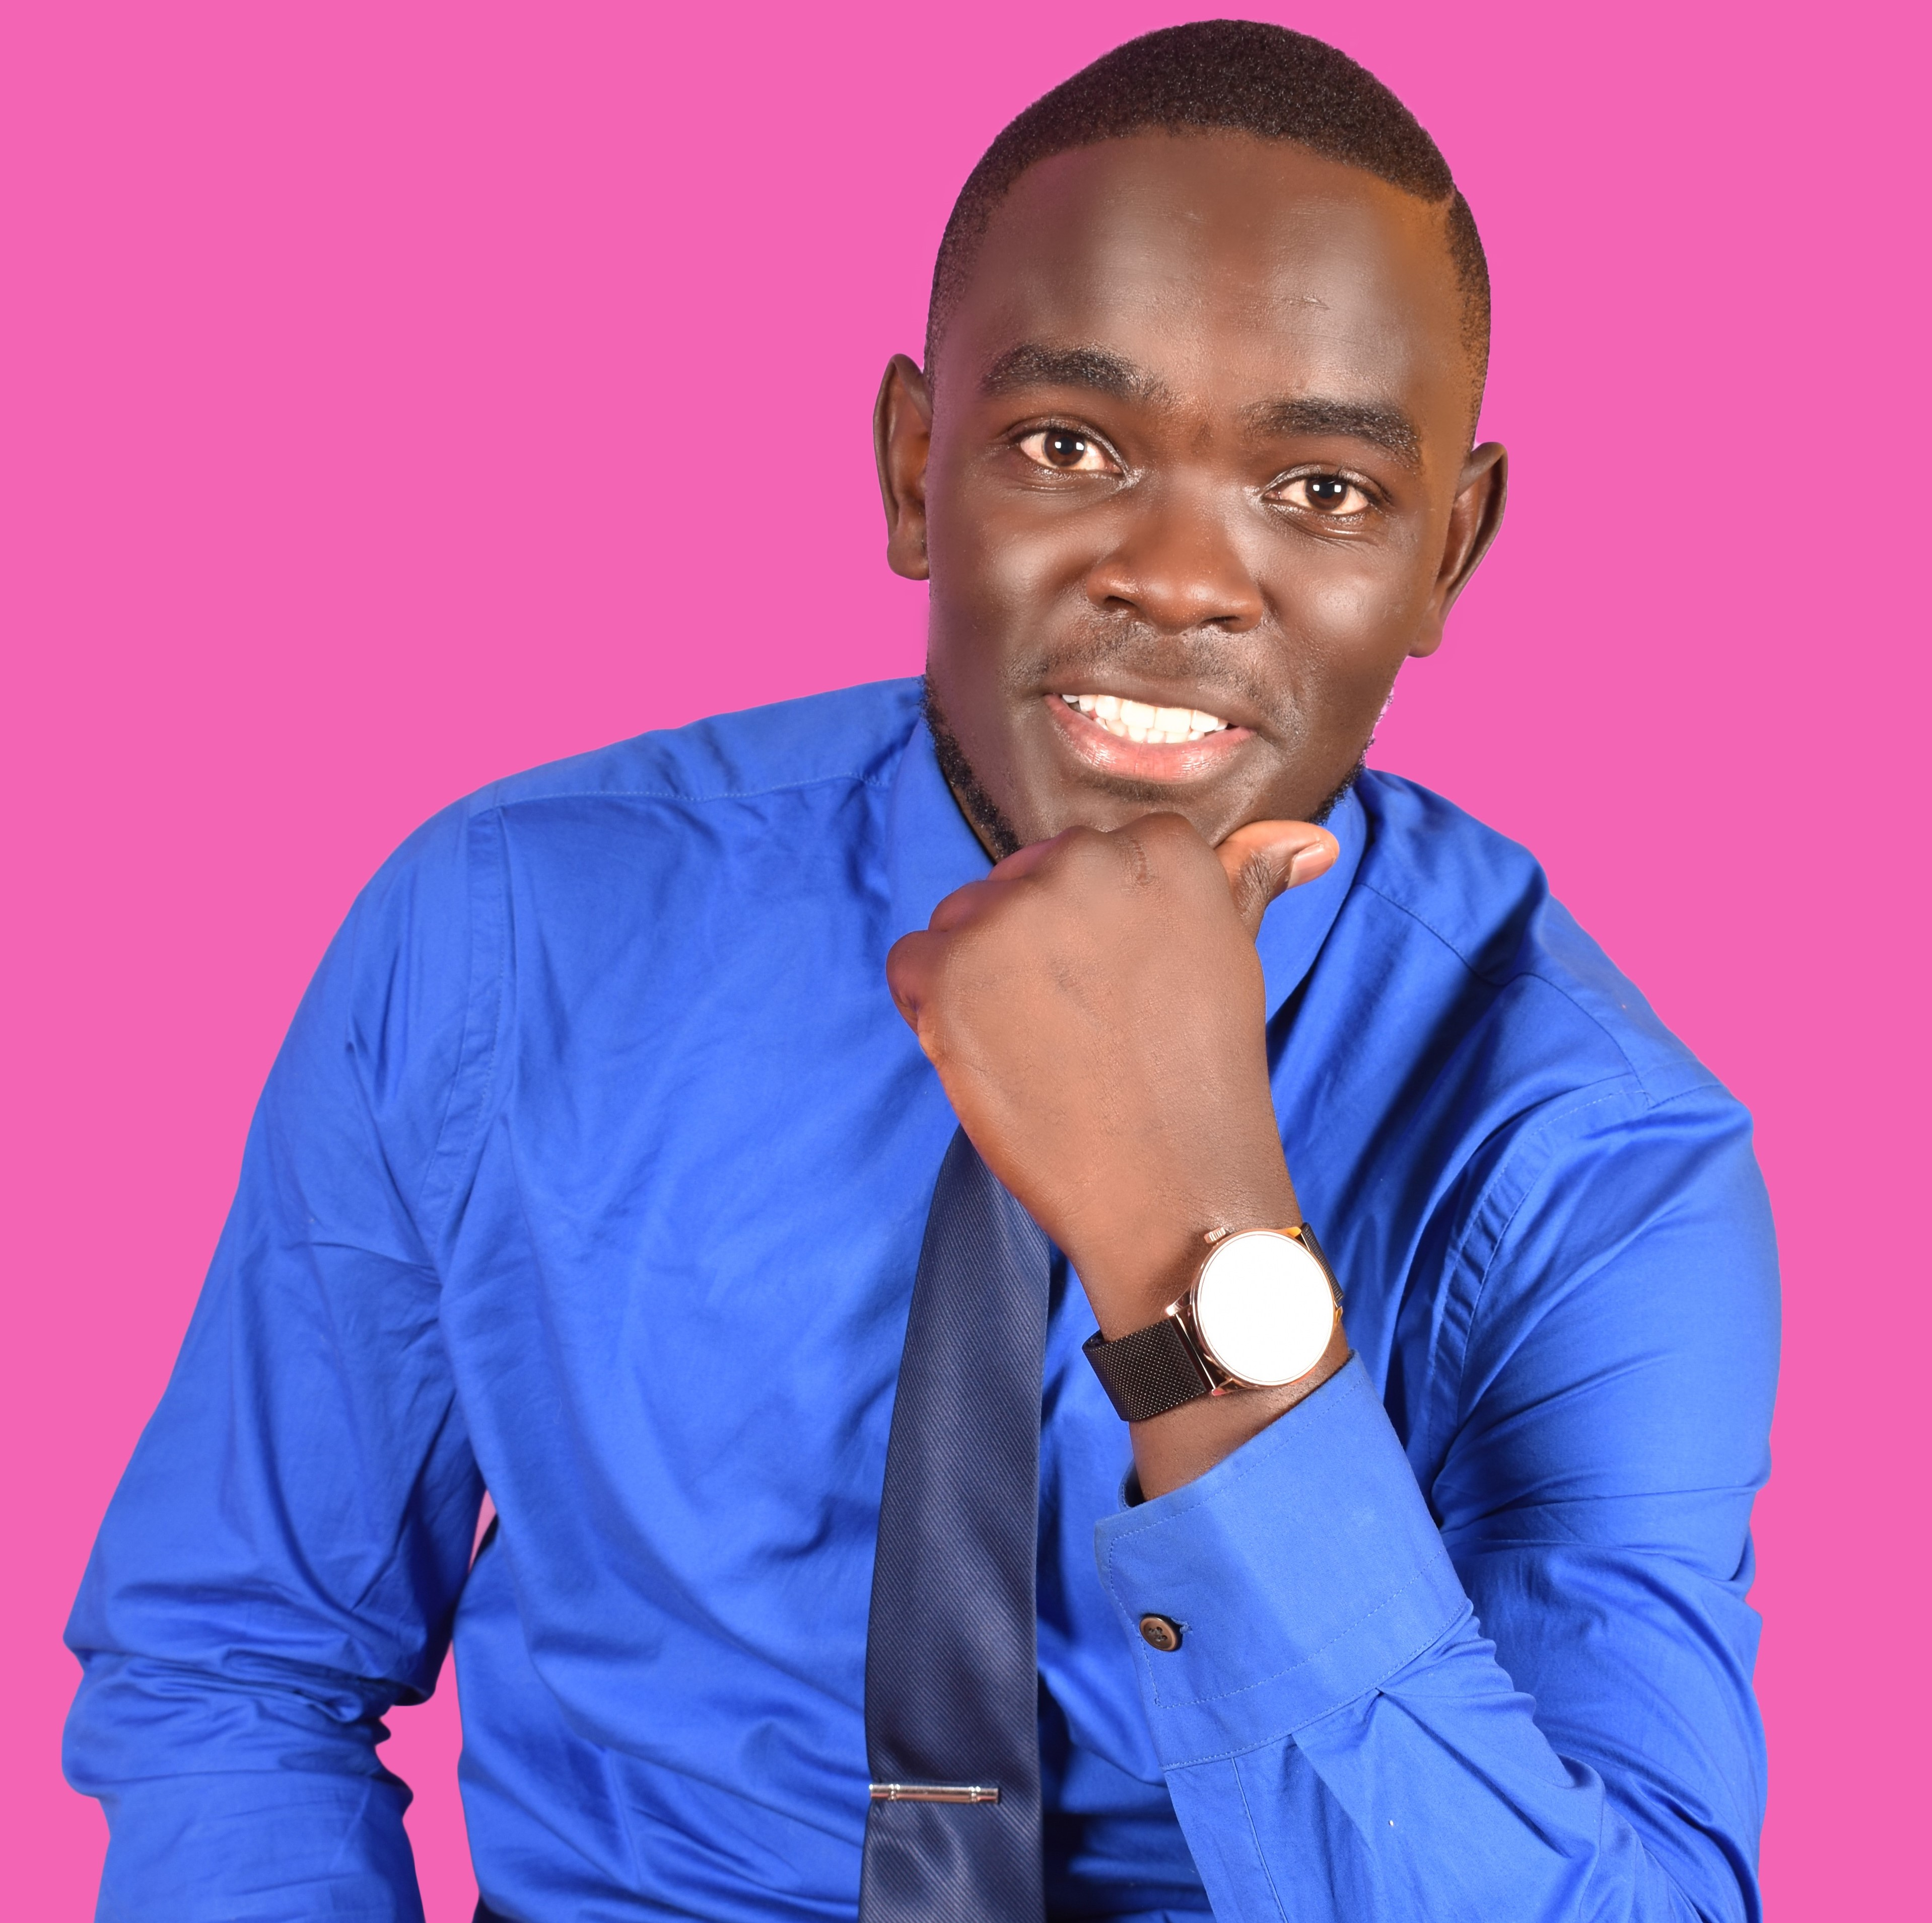
PRESENTER BIO AND PICTURE
Name: Oduor Kevin Otieno
Nationality: Kenyan
Age:27 years
Education: MPH at University of Manchester (CDLS)
Work experience: Chief Programs Officer at Stowelink, Consultant at IILA and ACERWC

Slide 4
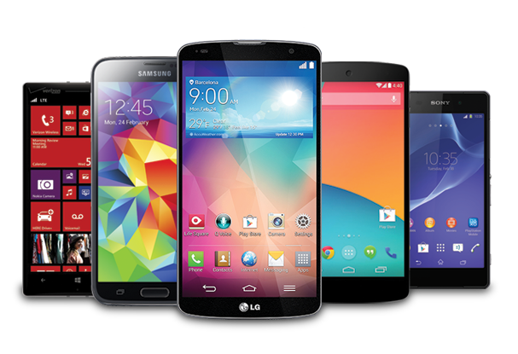
BACKGROUND INFORMATION
Over 70% mobile phone penetration (Global).
Smartphone adoption at 64 percent in Africa (75% by 2025).
An estimated 80% of mobile penetration (Kenya) and over 60% smartphone adoption.
Source: Further Africa

Slide 5
PURPOSE OF THE STUDY
Examine forms mHealth interventions in Kenya.
Effectiveness of mHealth interventions.
Barriers to mHealth interventions uptake.
Ways of integrating mHealth interventions.

Slide 6
METHODOLOGY
Preferred Reporting Items for Systematic Reviews checklist followed.
Search done on CINAHL and PUBMED utilizing PICOs framework.
Exhaustive terms including mHealth used.
Verified for rigor, authority and relevance.

Slide 7
RESULTS
Forms of mHealth (Call centers, SMS and mobile Apps).
Effectiveness of mHealth. Successfully used in collecting and transferring health and patient data, remote diagnosis, treatment, patient follow-up, behavior and cultural change and adaptation of new health-friendly behavior.
Challenges Facing mHealth Interventions. bureaucratic approval processes, security concerns, language barrier, interoperability challenges.

Slide 8

CONCLUSION AND RECOMMENDATION
Enormous potential in improving healthcare access and augmenting UHC.
mHealth interventions must ensure efficiency which is a component of usability.
Effective regulatory frameworks.
Forge partnerships with NGOs implementing mHealth solutions.
Increasing investment in technology and infrastructure.

Slide 9

GRATITUDE
Research publication sponsored by the WHO.

Slide 10

CONTACTS
Email: oduorkevin@Stowelink.com
LinkedIn: Oduor Kevin
Twitter: oduor_kevin1
Website: www.oduorkevin.com or www.stowelink.com

